Slide 1

EASWARI ENGINEERING COLLEGE
(AUTONOMOUS)
Bharathi Salai, Ramapuram, Chennai, 600089.
Devotees experience long waiting times due to unplanned crowd management and lack of real-time queue information
Department of Information Technology
SUBJECT NAME: FULL STACK DEVELOPMENT
SUBJECT CODE: 2311CSC503R
UNDER THE GUIDANCE OF
G. Sai Lakshmi
PRESENTED BY
Muthuveer M (310624205166)

Slide 2
CONTENTS :
      Title
      Abstract
      Introduction
      Literature survey
      Existing system and Disadvantages
      Proposed system and Advantages
      System requirements
      System Architecture
      Modules implemented
      System design and wait-time engine
      Prediction module
      Implementation results and testing
      References

Slide 3
ABSTRACT
Devotees at temples and pilgrimage centres often wait for several hours because entry is managed manually and no reliable information about queue length or expected waiting time is available to them. This project proposes a Smart Darshan system that replaces the physical waiting line with a virtual queue. Devotees book a darshan slot through a web application, or collect a walk-in token at the temple counter or kiosk, and receive a QR-coded digital token. The token is scanned at the entry and exit gates, which keeps the live count of devotees inside accurate, and the system computes the estimated waiting time from the number of devotees ahead and the measured service rate. A prediction module trained on historical footfall data forecasts peak hours and recommends less crowded slots, while an administrator dashboard shows live lane-wise crowd status and raises an alert when the queue nears its safe limit. The result is shorter waiting, planned crowd distribution and transparent real-time queue information for every devotee.

Slide 4
INTRODUCTION
Temples and pilgrimage centres in India receive thousands of devotees every day, and the number multiplies during festivals and auspicious days. Entry is usually regulated manually with physical queue lines and barricades, so devotees have no way of knowing how long they must wait or which gate is less crowded. This results in waiting times of several hours, congestion at entry points, discomfort for elderly devotees and children, and in extreme cases serious safety risks such as stampedes. Temple administrators also lack a live picture of how many devotees are present in each zone, which makes it difficult to open extra counters or redirect the flow before congestion builds. This project addresses these problems by developing a slot-based virtual queue system with QR-verified entry, real-time queue status and predictive crowd analytics, so that devotees wait comfortably instead of standing in long physical lines.

Slide 5
LITERATURE SURVEY :
AUTHOR | YEAR OF PUBLICATION | DESCRIPTION | PROS | CONS
Bhuiyan et al. | 2022 | Applied a CNN-based crowd counting model to Hajj pilgrimage video footage to estimate density in very dense gatherings. | Measures crowd density automatically, without any manual head counting. | Needs dense camera coverage and GPU hardware; reports density, not individual waiting time.
Kawade et al. | 2025 | Proposed an IoT-based temple crowd management system using IR, ultrasonic and air-quality sensors with servo-controlled gates. | Monitors devotee flow and congestion at each gate in real time. | Requires sensor hardware at every gate; gives devotees no queue position or advance slot booking.
Dinesh Reddy et al. | 2026 | Developed a smart slot-based darshan management system with QR-verified time slots and predictive analytics for administrators. | Spreads arrivals across booked slots and reduces physical queueing. | Depends on smartphone access; no live gate-level counting to update waiting time continuously.

Slide 6
EXISTING SYSTEM :
Crowd handling at most temples today is manual. Devotees stand in physical queue lines regulated by staff and barricades, and entry is controlled by opening or closing gates as the crowd builds up. Some large temples issue paper tokens at a counter, and a few offer online portals that only confirm a darshan date and time.
The commonly used approaches are:
    Manual queue and barricade management – Staff physically regulate devotee flow, but decisions are reactive and depend on individual judgement.
    Counter-issued paper tokens – Devotees collect a token at the temple itself, which still requires them to travel early and wait on site.
    Online slot booking portals – Allow advance booking of a date and time, but give no live queue position or updated waiting time.
    CCTV-based visual monitoring – Staff watch camera feeds to judge congestion manually, without any automatic counting or alerting.

Slide 7
DISADVANTAGES :
        No Real-Time Queue Information – Devotees cannot see their queue position or expected waiting time, so they wait without any idea of how long it will take.
        Unplanned Crowd Distribution – Arrivals are not spread across the day, causing heavy congestion at peak hours while other hours remain under-used.
        Reactive Manual Control – Gate and counter decisions are taken by staff only after congestion has already built up, not before it occurs.
        Poor Accessibility and Safety – Elderly devotees, children and differently-abled visitors are forced to stand in long physical lines, increasing health and stampede risks.
        No Data for Planning – Footfall is not recorded digitally, so administrators have no reliable basis to forecast peak days or plan staff and counters.

Slide 8
PROPOSED SYSTEM :
  The proposed system replaces physical waiting with a slot-based virtual queue. Devotees book a darshan slot through a web or mobile application, or at a kiosk, and receive a QR-coded digital token instead of standing in a line.
  At the entry gate the token is scanned, which automatically updates the live count of devotees admitted. The queue engine computes the estimated waiting time from the number of devotees ahead and the measured service rate, and pushes it to the devotee's app, to display boards and by SMS through real-time Socket.IO updates.
  A prediction module trained on historical footfall forecasts peak hours and recommends less crowded slots, while an administrator dashboard shows live lane-wise crowd status, raises alerts at 90% and 100% of the safe limit and lets staff pause entry before congestion builds.

Slide 9
ADVANTAGES :
        Reduced Waiting Time – Slot-based virtual tokens spread arrivals across the day and remove long physical queues at the entrance.
        Real-Time Transparency – Devotees see their live queue position and estimated waiting time on the app, on display boards or by SMS.
        Proactive Crowd Control – The admin dashboard and peak-hour forecast let staff act before congestion builds instead of reacting after it.
        Inclusive Access – SMS and kiosk-based tokens cover devotees without smartphones, and elderly and differently-abled visitors avoid standing in line.
        Data-Driven Planning – Digitally recorded footfall gives administrators reliable data to plan counters, staff and festival arrangements.

Slide 10
SYSTEM REQUIREMENTS & SPECIFICATIONS
HARDWARE SPECIFICATIONS:
PROCESSOR : Intel Core i3 / 2.5 GHz or above
RAM : 4 GB (Minimum), 8 GB Recommended
HARD DISK : 40 GB
INPUT DEVICE : Keyboard / Webcam or smartphone camera for QR scanning
MONITOR : Minimum Resolution 1920*1080
SOFTWARE SPECIFICATIONS:
OPERATING SYSTEM : Windows 10 or Above
PROGRAMMING LANGUAGE & VERSION : JavaScript (Node.js 20+, ES modules), Python 3.10
PLATFORM : VS Code, Node.js 22, MongoDB 7 (local or Atlas)
SUPPORTING LIBRARIES : React 19 + Vite, Tailwind CSS, Recharts, Express 5, Socket.IO 4,
Mongoose 9, JWT, Flask, Scikit-learn, Pandas, Twilio SMS API

Slide 11
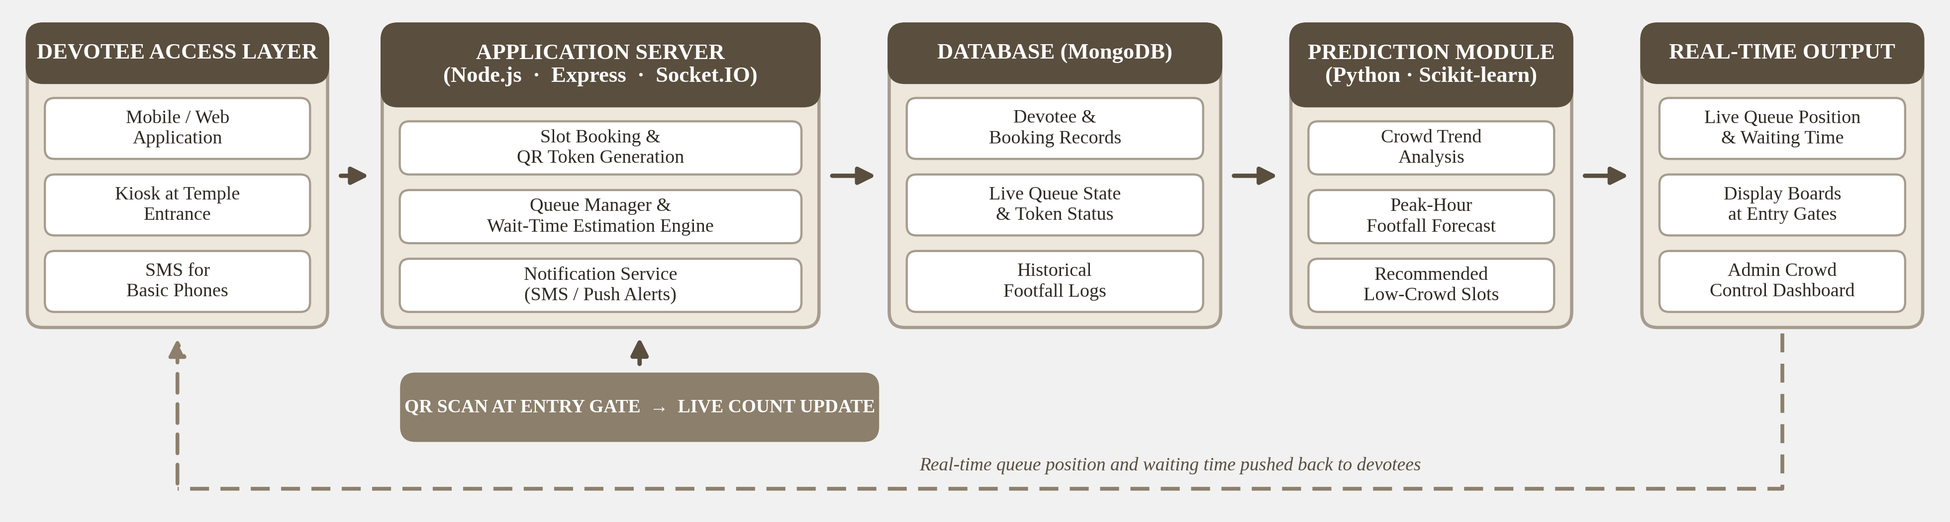
SYSTEM ARCHITECTURE :

Slide 12
MODULES IMPLEMENTED :
        Devotee module – Temple search with live waiting time, slot booking for a group, QR token, live queue position, reminders and cancellation.
        Gate staff module – QR scanning at the entry and exit gates, a walk-in token counter with printable slips, and a live view of every queue lane.
        Kiosk and display board – Self-service token kiosk at the entrance and a full-screen board showing live queues and the least crowded hours.
        Temple admin module – Crowd dashboard, occupancy alerts, pause or resume entry, slot capacity, announcements, staff accounts and festival calendar.
        Superadmin module – Onboarding of new temples along with their admin account, and platform-wide monitoring of every temple.

Slide 13
SYSTEM DESIGN :
        Database – MongoDB collections for users, temples, slots, tokens, hourly footfall logs, announcements and crowd alerts.
        Slot generation – Slots are created automatically for the booking window from each darshan type's duration and capacity; festival days get extra capacity.
        Capacity split – Every slot keeps one quota for online booking and one for walk-ins, and unsold online seats are released to walk-ins before the slot starts.
        Token lifecycle – Booked, checked-in at the entry scan and completed at the exit scan; missed and cancelled tokens are closed by scheduled jobs.
        Safe concurrency – Seats are reserved with a single atomic database update, so simultaneous bookings can never exceed the capacity of a slot.

Slide 14
WAIT-TIME ENGINE :
        Live queue count – Entry scans add devotees to a lane and exit scans remove them, so the count always reflects the crowd actually inside.
        Service rate – The engine measures how many devotees complete darshan in the last 15 minutes, and uses the designed capacity until enough exits are seen.
        Waiting time – Estimated wait = devotees in queue ÷ measured service rate, calculated separately for each darshan lane.
        Real-time delivery – Every scan republishes the queue snapshot over Socket.IO to devotee phones, display boards and the admin dashboard.
        Crowd control – Alerts are raised at 90% and 100% of the safe limit, and entry can be paused at all gates instantly or automatically.

Slide 15
PREDICTION MODULE :
        Training data – Every gate scan updates an hourly footfall log; 90 days of history per temple were used for training and evaluation.
        Features – Hour of the day with cyclic encoding, day of week, weekend flag, month and festival flag.
        Model – A Random Forest Regressor of 200 trees is trained for each temple in a Python (Flask) service and evaluated on a 20% test split.
        Accuracy – R² of 0.91 to 0.94 with a mean absolute error of 13 to 39 visitors per hour, about 24% lower error than a weekday-hour average baseline.
        Output – Hourly crowd forecast, peak hour and the three least crowded hours; historical averages are used if the prediction service is offline.

Slide 16
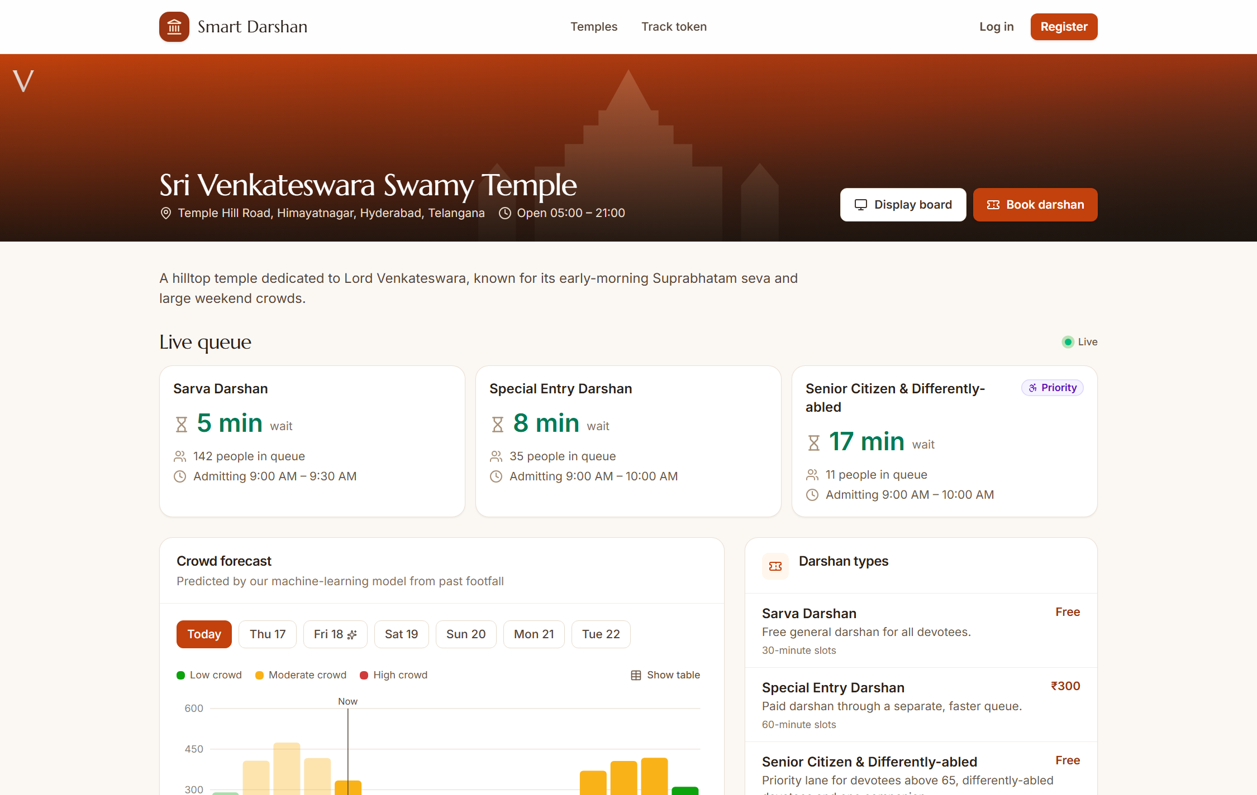
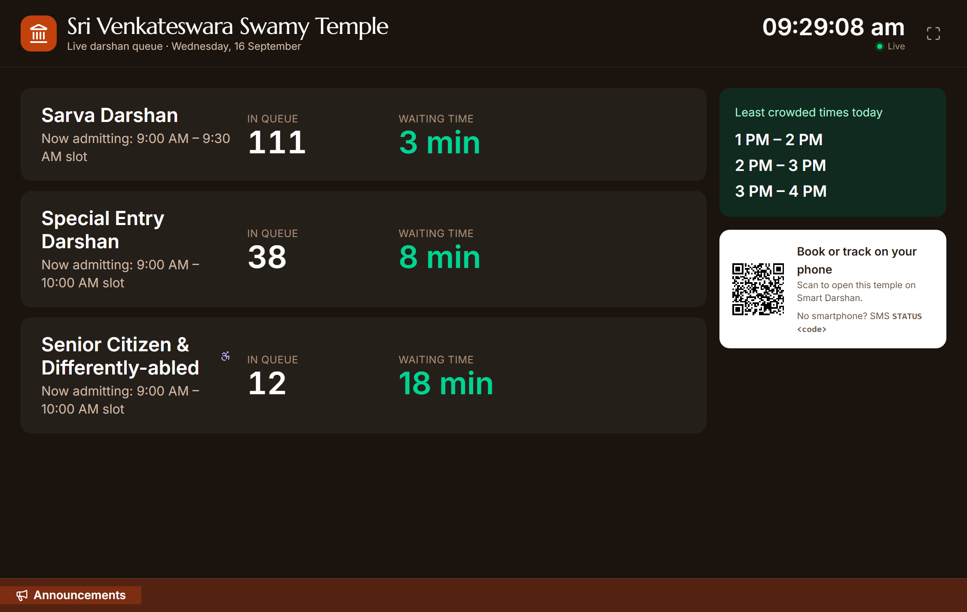
IMPLEMENTATION – DEVOTEE VIEW :
Temple page: live queue per darshan lane and hourly crowd forecast
Entry display board: live waiting time and least crowded hours

Slide 17
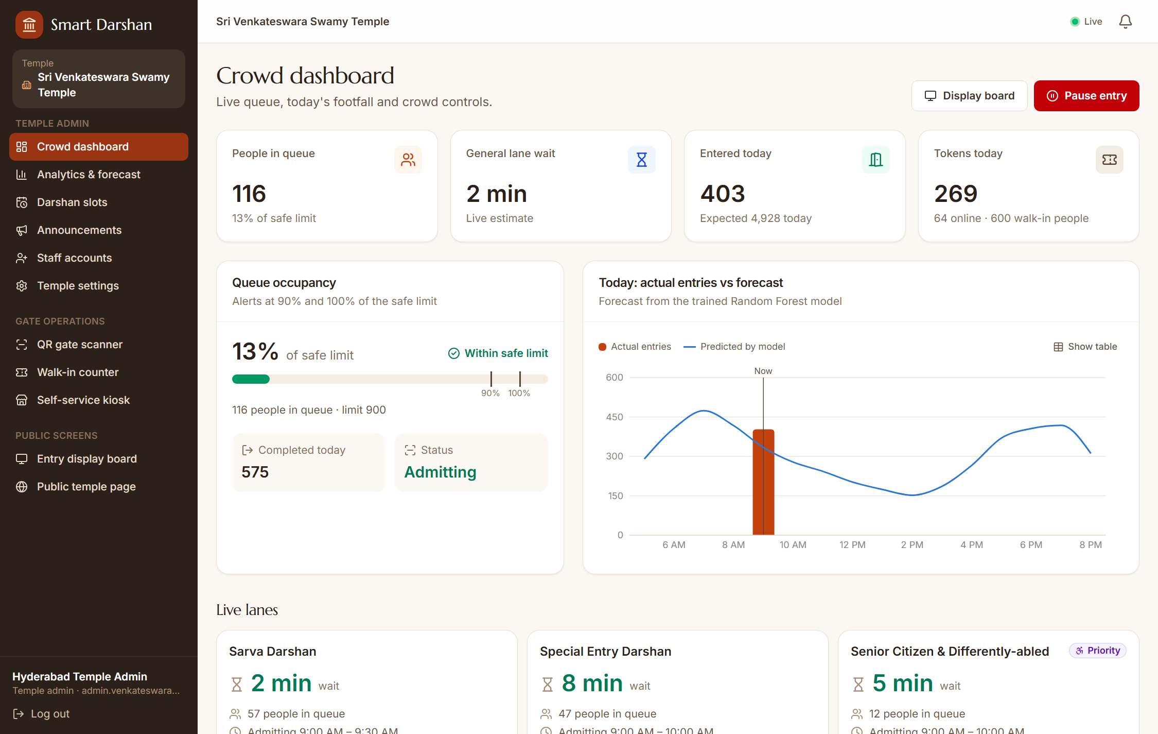
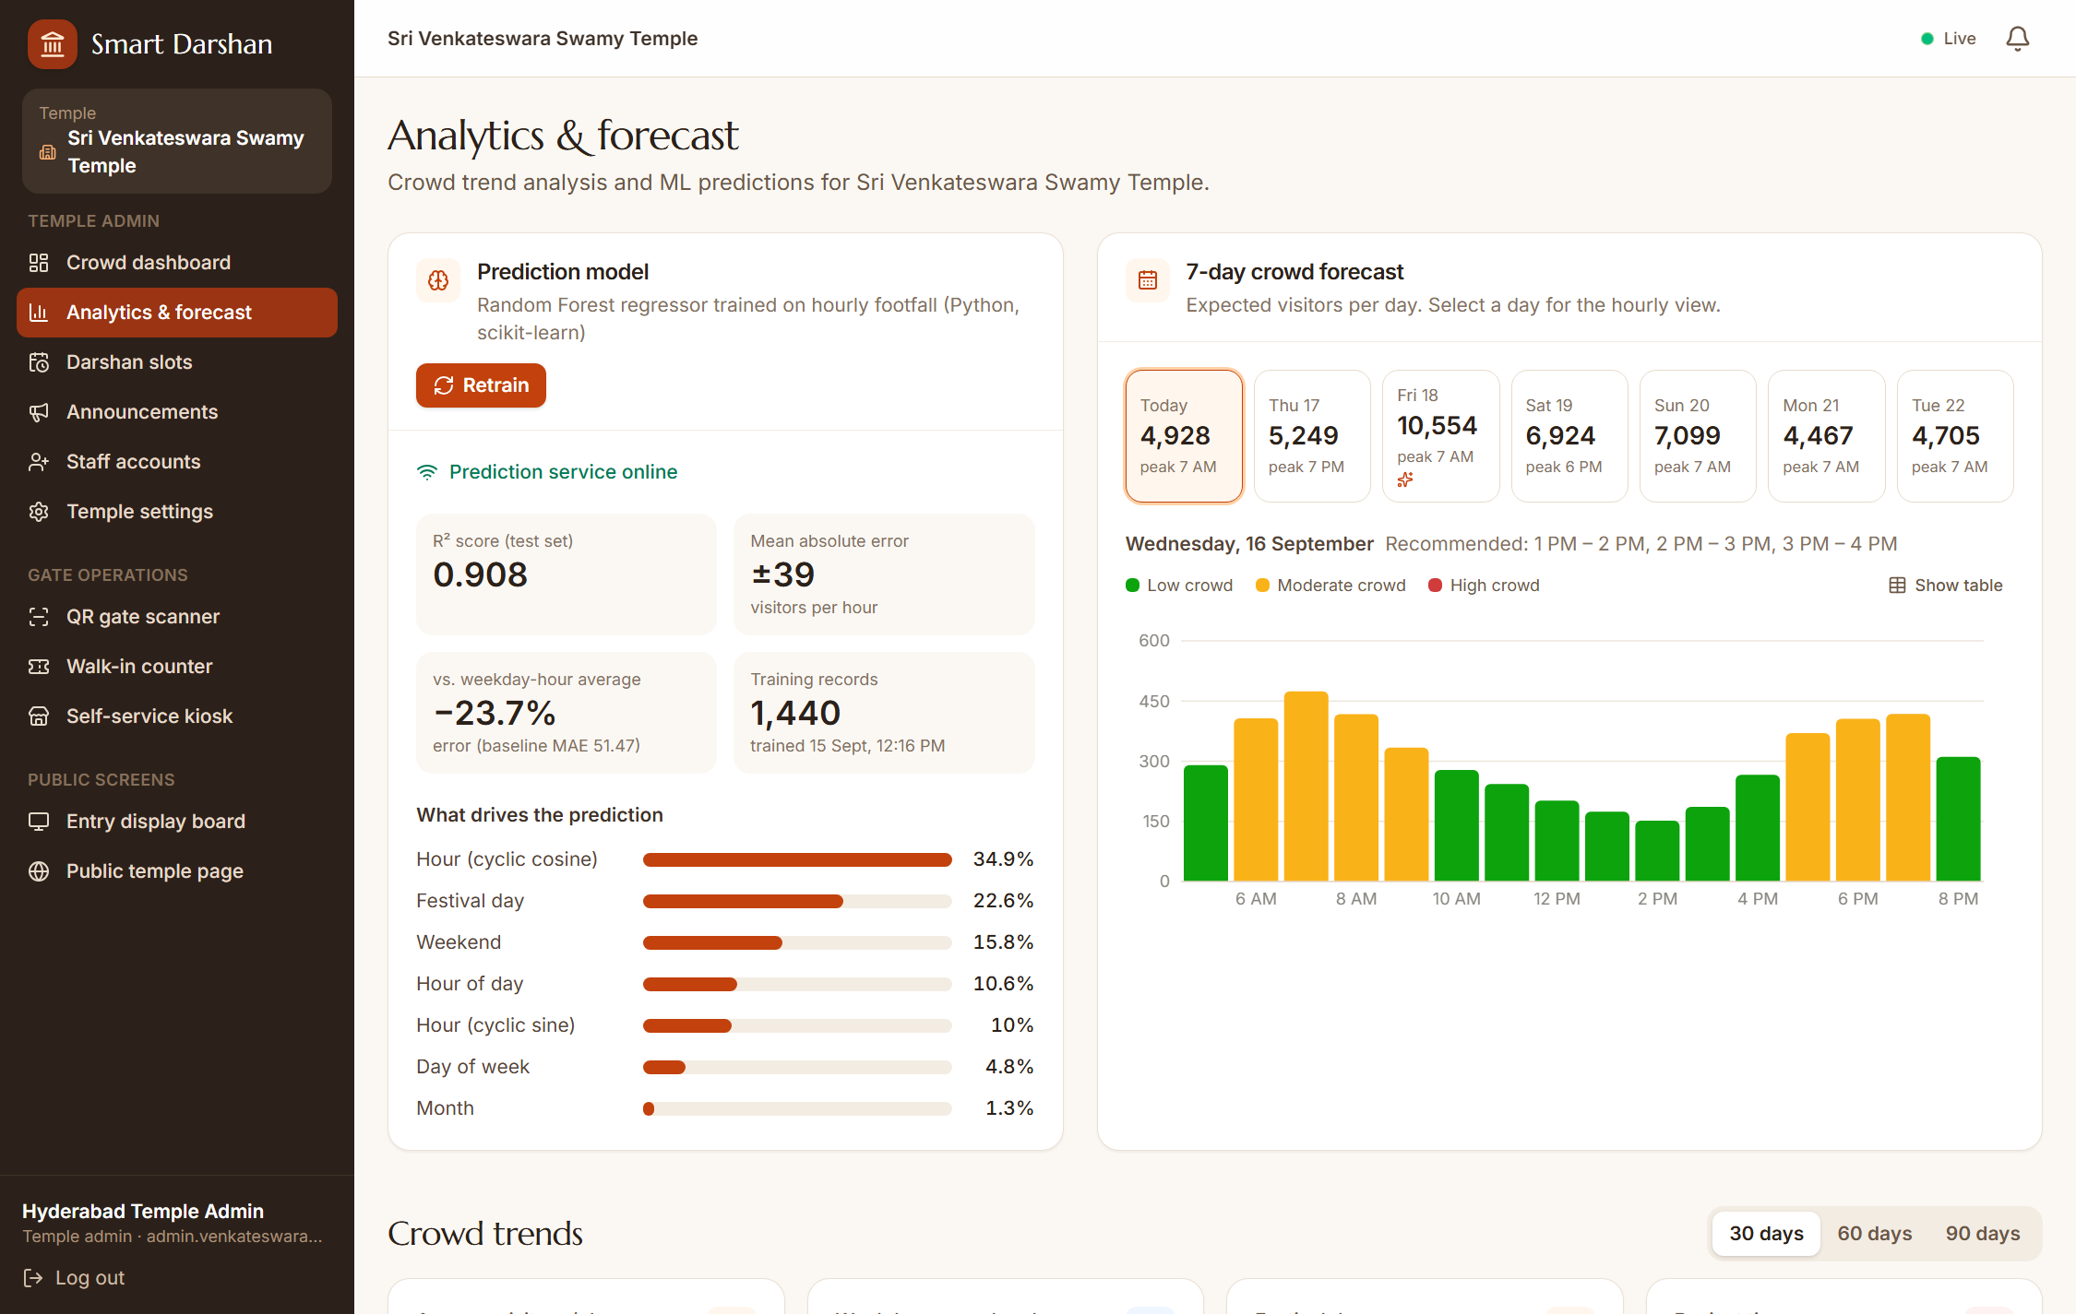
IMPLEMENTATION – ADMIN VIEW :
Crowd dashboard: live occupancy, alerts and entry control
Analytics: prediction model accuracy and 7-day forecast

Slide 18
TESTING & VALIDATION :
        Automated API tests – 49 end-to-end checks covering booking, gate scans, cancellation, admin controls and SMS replies, all passing.
        Booking limits – Slot capacity, group size and the per-devotee daily limit are each rejected correctly, and seats are released when a booking is cancelled.
        Gate scan validation – Early entry, missed slots, repeated scans, exit before entry and paused entry are refused with a clear message to the staff.
        Access control – Staff and admins are restricted to their own temple, and a superadmin must select a temple before managing it.
        Crowd simulation – A simulator issues walk-in tokens and scans continuously, confirming that waiting times, alerts and display boards update live.

Slide 19
REFERENCES :
      Bhuiyan, M.R.; Abdullah, J.; Hashim, N.; Al Farid, F.; Uddin, J.; Abdullah, N.; Samsudin, M.A. Crowd density estimation using deep learning for Hajj pilgrimage video analytics. F1000Research 2022, 10:1190.
      Kawade, S.; Pawar, R.; Shewale, S.; Tatar, V.; Bhor, S.R. Temple Crowd Management and Elevation System Using IoT. IJSRD – International Journal for Scientific Research & Development, Vol. 13, Issue 2, 2025.
      Reddy, M.D.; Narasimha, K.; Lakshmi Kumari. Smart Slot-Based Darshan Management System (Rapid Darshan). International Journal of Engineering Research & Technology (IJERT), Vol. 15, Issue 5, 2026.
      Yu, Q.; Zhang, Y.; Zhou, Y.-P. Delay Information in Virtual Queues: A Large-Scale Field Experiment on a Major Ride-Sharing Platform. Management Science, 2022. https://doi.org/10.1287/mnsc.2022.4448
      KPMG in India. Faith and Flow: Navigating Crowds in India's Sacred Spaces, August 2025. Available online: https://kpmg.com/in/en/insights/2025/08/faith-and-flow-navigating-crowds-in-indias-sacred-spaces.html (accessed on 6 September 2026).

Slide 20
THANK YOU !

